Slide 1
Healthcare Management System
By Team 19
Shivani Datar - 002772160
Neha Shende - 002783740
Akshat Agrawal - 002743266
Gaurav Chouksey - 002667251

Slide 2
Objectives
The purpose of the database is to provide a patient-centered healthcare system to the hospitals that facilitate monitoring and improvement of their services. Through this database we:-
• Provide accurate, up-to-date, and complete information about patients.
• Enable quick access to patient records for more coordinated, efficient care.
• Help healthcare providers more effectively diagnose patients, reduce medical errors, and provide safer care.
• Enable healthcare providers to improve efficiency and meet their business goals.
• Reduce costs through decreased paperwork, improved safety, reduced duplication of testing, and improved
health.

Slide 3
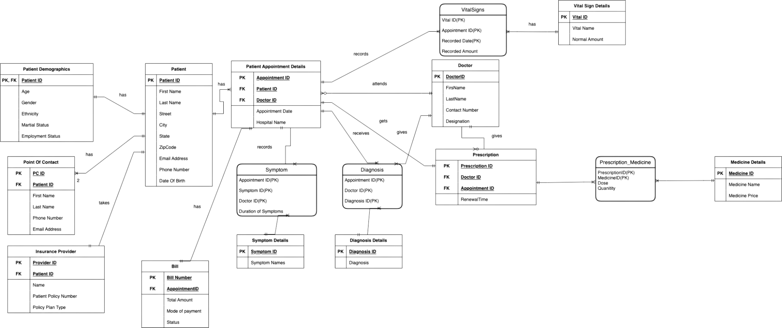
E - R DIAGRAM

Slide 4
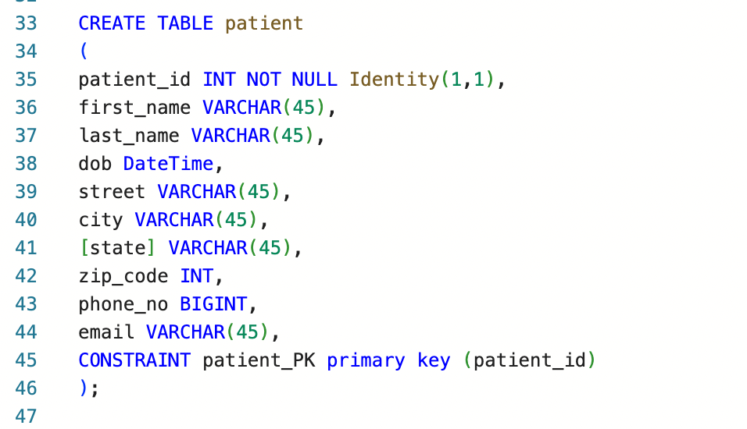
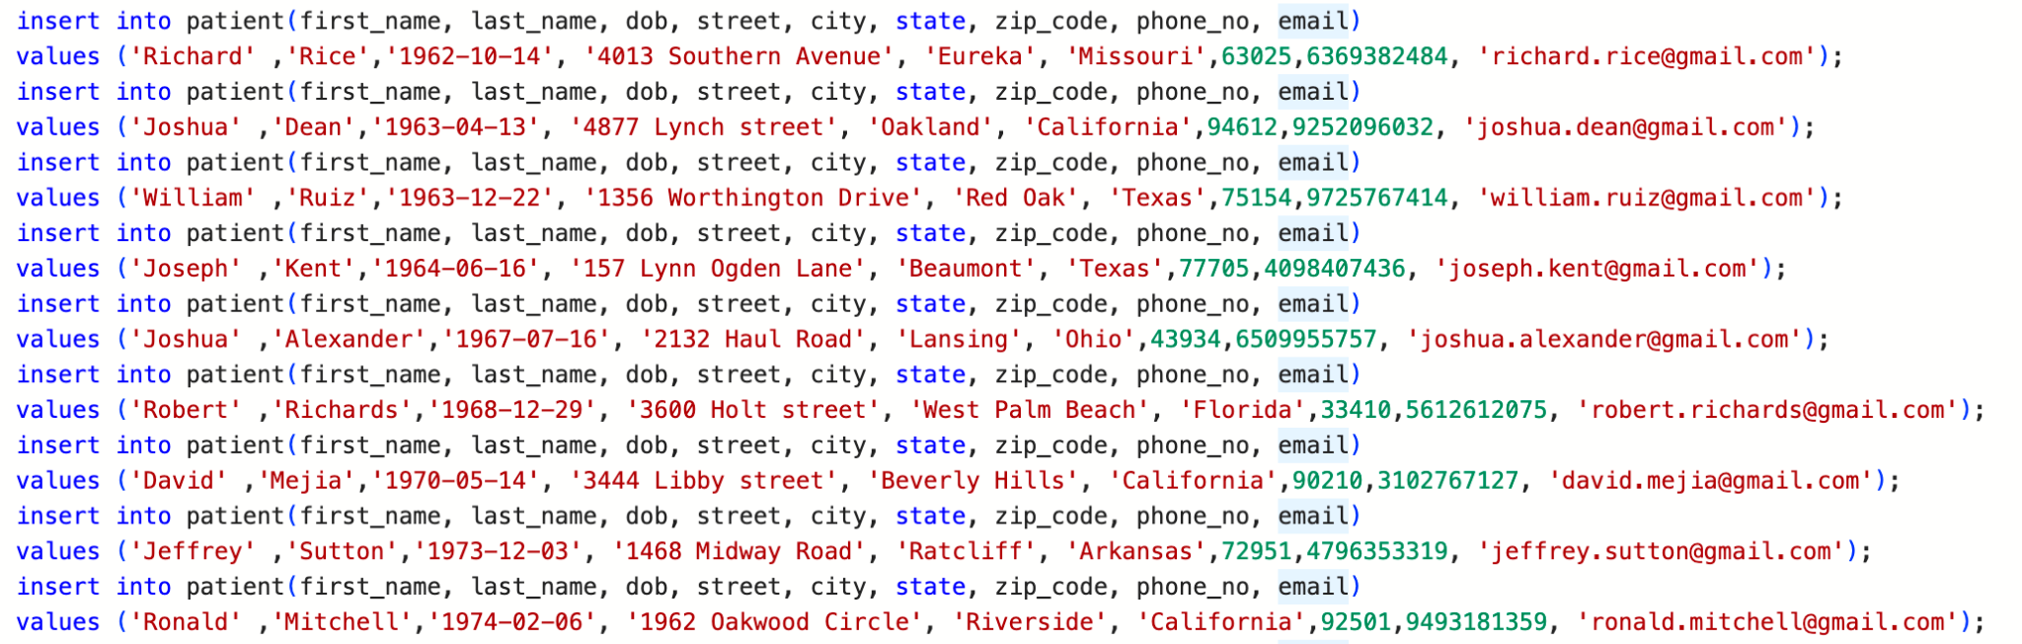
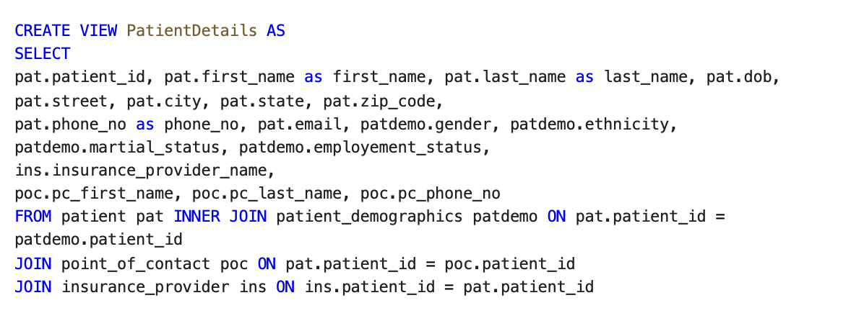
DDL,DML,VIEWS

Slide 5
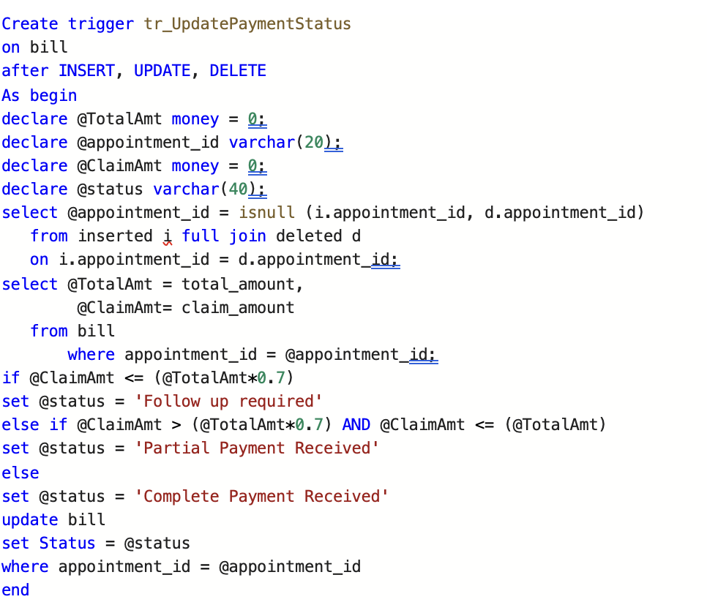
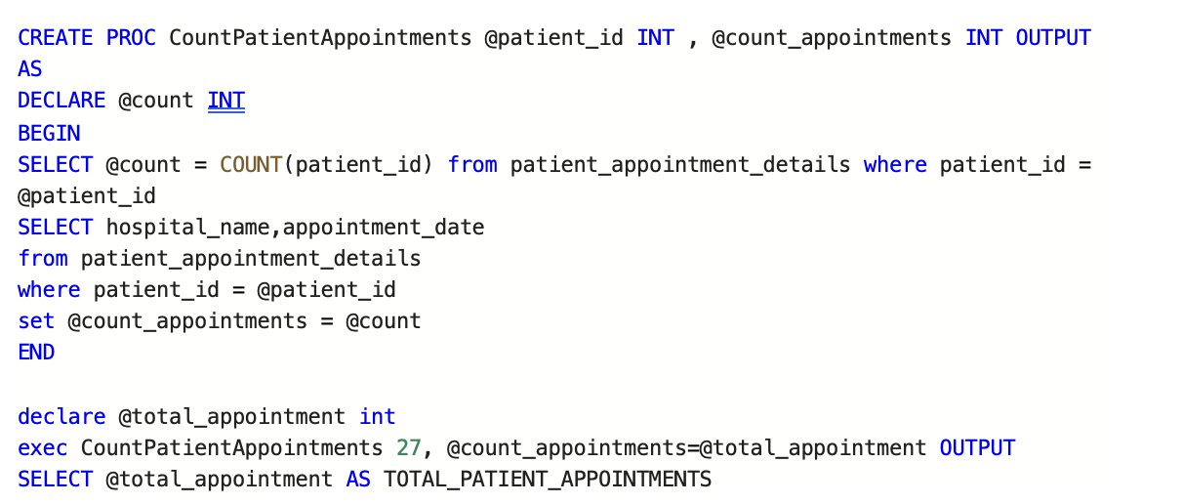
Stored Procedure
Trigger

Slide 6
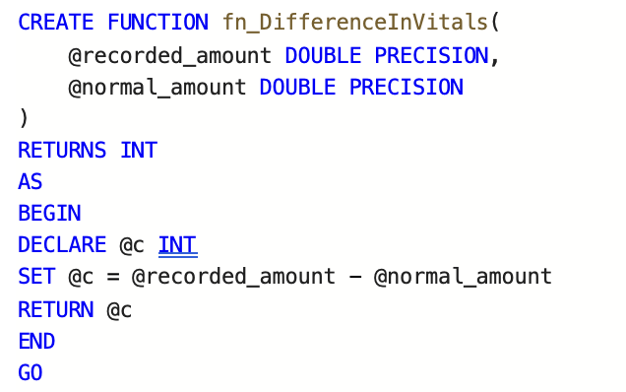
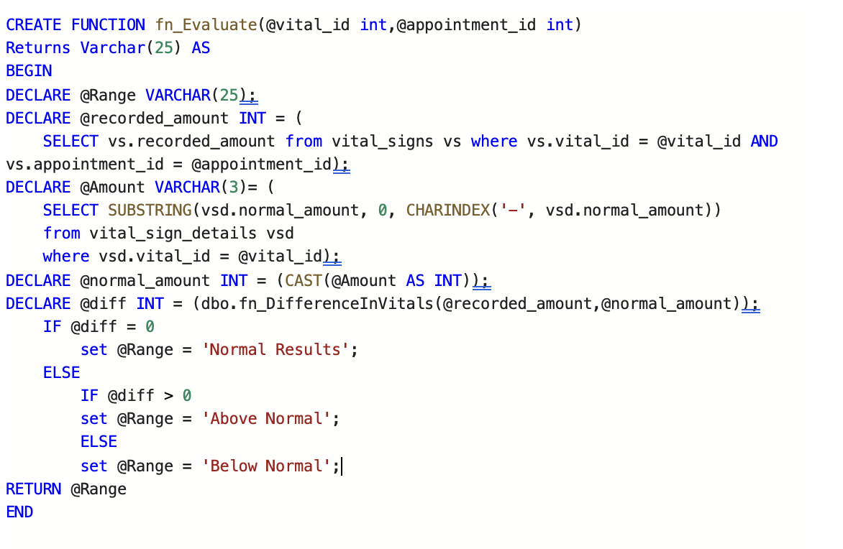
Function 1
Function 2

Slide 7
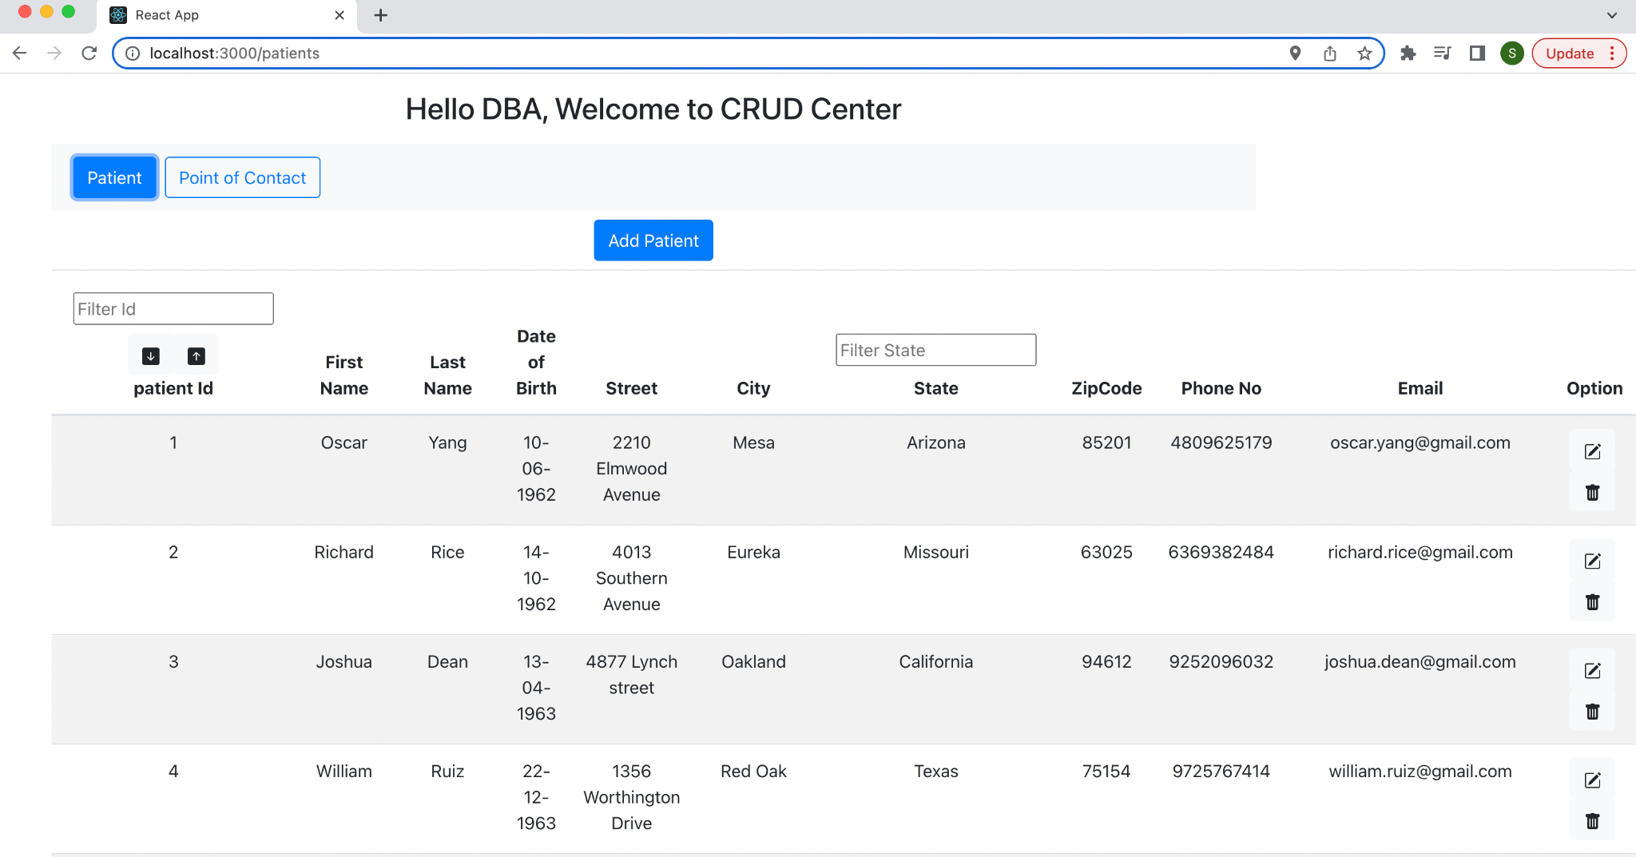
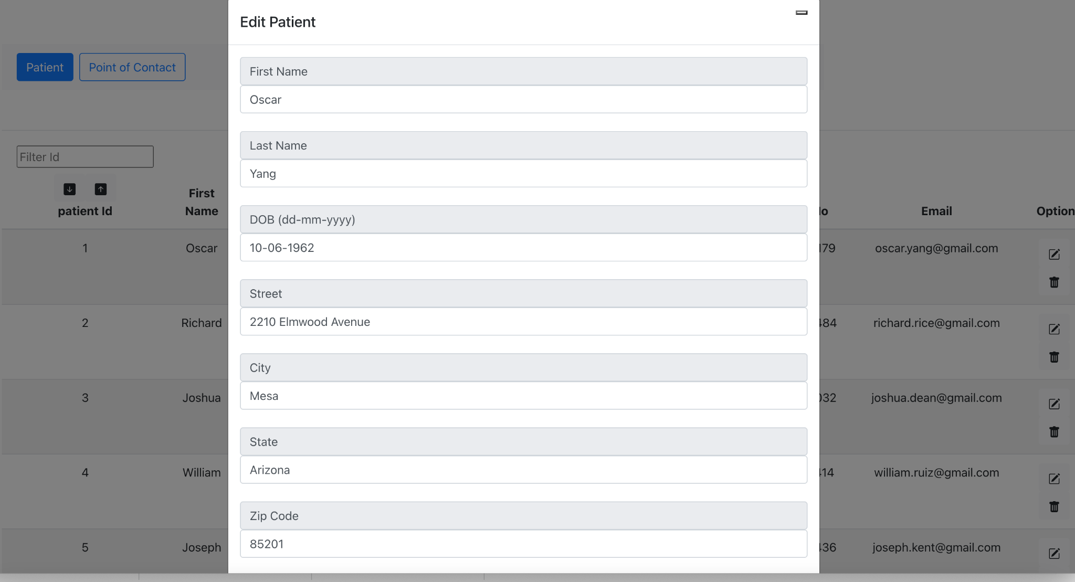
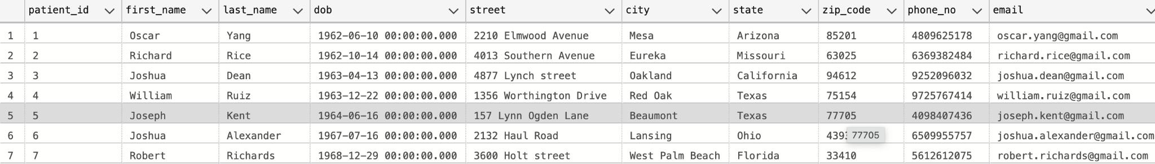
GUI Landing Page
GUI Edit Pop-up
SQL Data

Slide 8
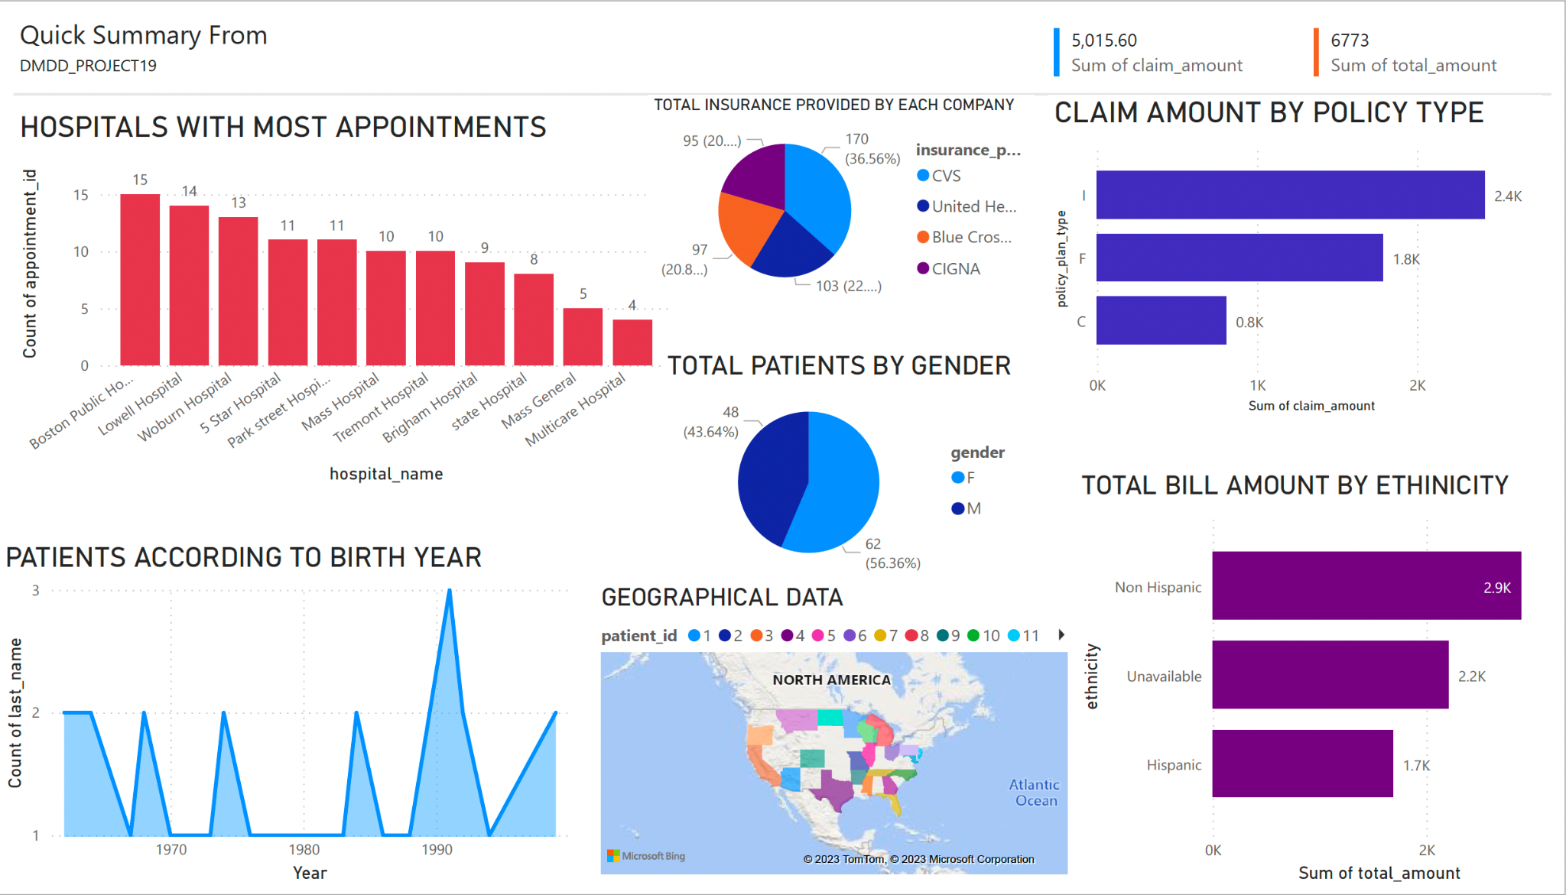
DashBoard

